Slide 1
The Thermohaline Circulation – why does it happen?
What is the overturning circulation?
Overturning circulation processes: description
North Atlantic Deep Water formation
N. Atlantic meridional overturning circulation summary

Slide 2
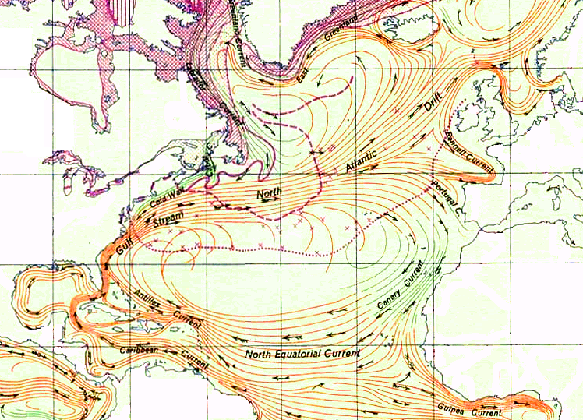
So far we have focused on only the surface wind driven currents - BUT WHY LIES BENEATH?

Slide 3
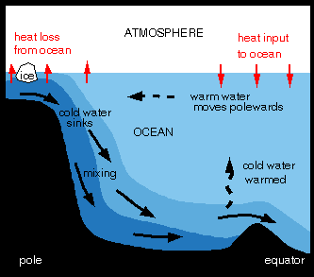
While the surface circulation is driven by wind, the deep circulation is driven by density differences and is often referred to as thermohaline circulation.
The term thermohaline circulation has been dropped in favor of meridional overturning circulation.

Slide 4
The oceans can be divided into 2 layers
Ekman Layer
“Upper Waters” primarily wind-driven
“Deep Waters” primarily density-driven

Slide 5
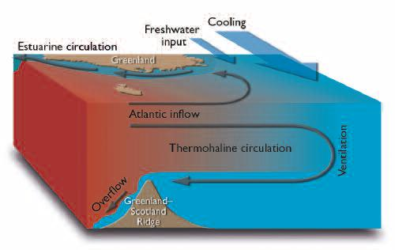
Strong thermohaline circulation mixes with the relatively fresh Arctic water, keeping the salinity relatively high. This allows for the formation of NADW.
However, formation of NADW is very sensitive to salinity. If waters in the Artic get fresher it is possible, that this could weaken or shut down the conveyor circulation.
It has been suggested that there may be a feedback between the conveyor circulation and climate. Strong conveyor circulation leads to warmer arctic which melts back the polar ice. This dilutes the water in the North Atlantic preventing formation of NADW and shutting down the conveyor circulation. Without redistribution of heat by the conveyor, polar regions get colder, ice grows, water becomes more salty, which allows NADW to begin forming again. And so on and so on.

Slide 6
Definitions:
Thermohaline circulation: widely used to describe this very large-scale overturn. Involves sources of dense water and Deep Western Boundary Currents and return warm flow to feed the isolated dense sources.
Thermohaline forcing can also be important on more local scales and in the upper

Slide 7
Thermohaline = temperature and salinity processes
Thermohaline processes that most strongly impact deep waters:
deep convection: 1000 to 1500 dbar (or more) overturn due to buoyancy loss (mostly cooling that causes densification)
brine rejection: salt rejected from sea ice during formation, most effective when mixed into a shallow layer, say, on a continental shelf. B.R. in some special sites makes the densest ocean waters.
North Atlantic Deep Water formation

Slide 8
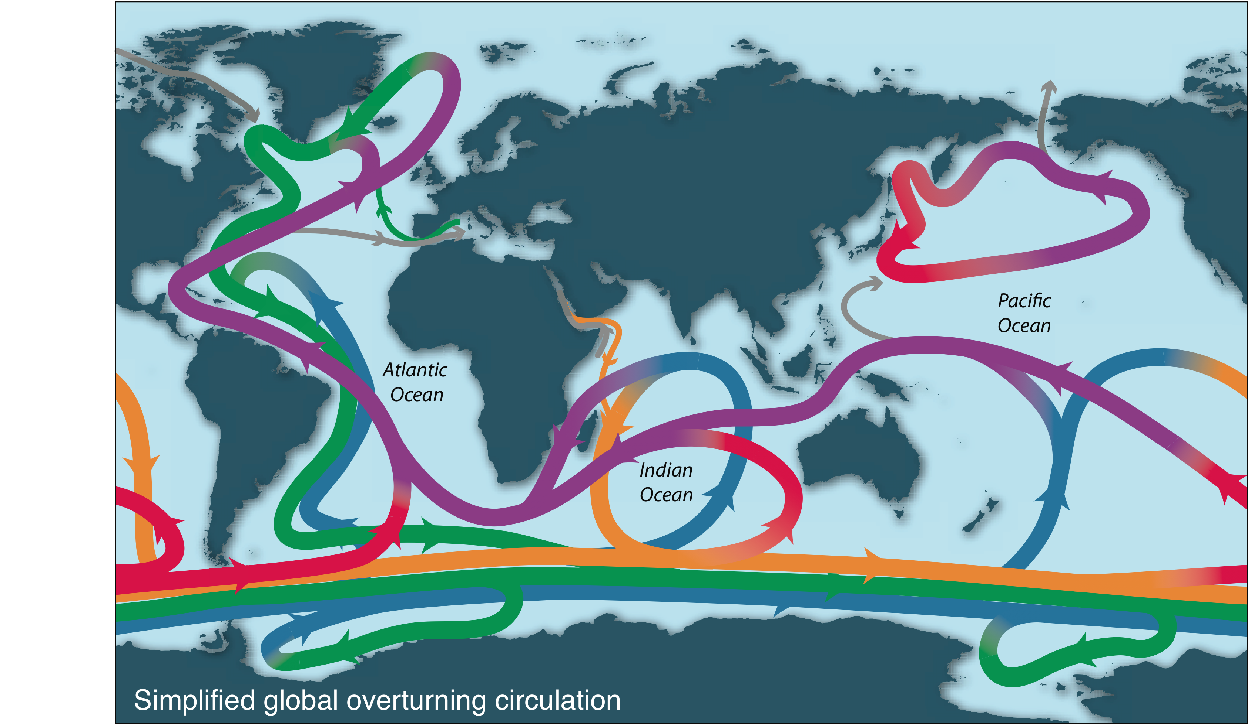
What does it look like? Thermohaline Circulation
Notes:
Make curves thinner? Add Red Sea?

Slide 9
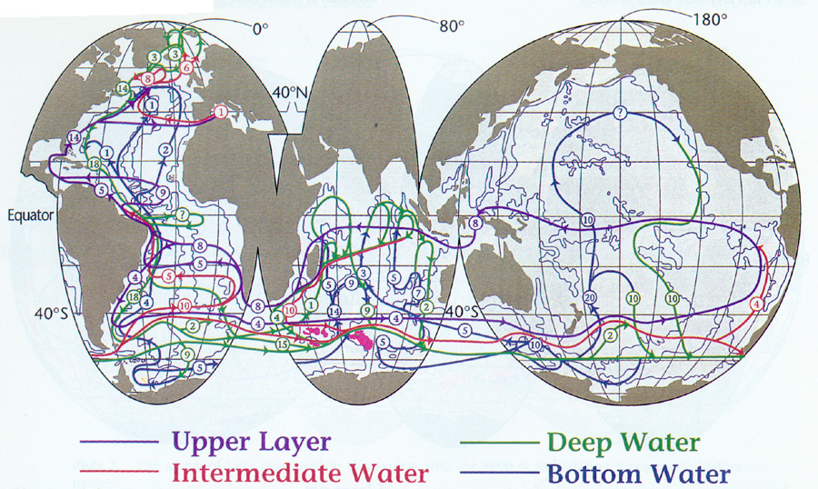
Size of meridional overturning circulation: about 15 to 20 Sverdrups (transports are circled)
(Thermocline water)
(Intermediate waters - above about 10°C)
(North Atlantic Deep Water including Labrador Sea)
(Antarctic Bottom Water)

Slide 10
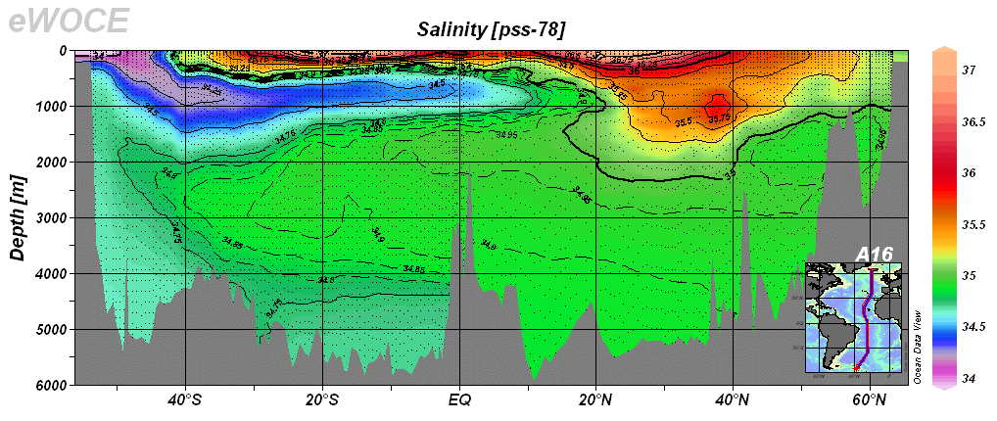
Observations of deep circulation are very difficult and as a result, we have much fewer direct observations of deep circulation. Much of our understanding of deep circulation comes from identifying water masses (temperature and salinity distribution).

Slide 11
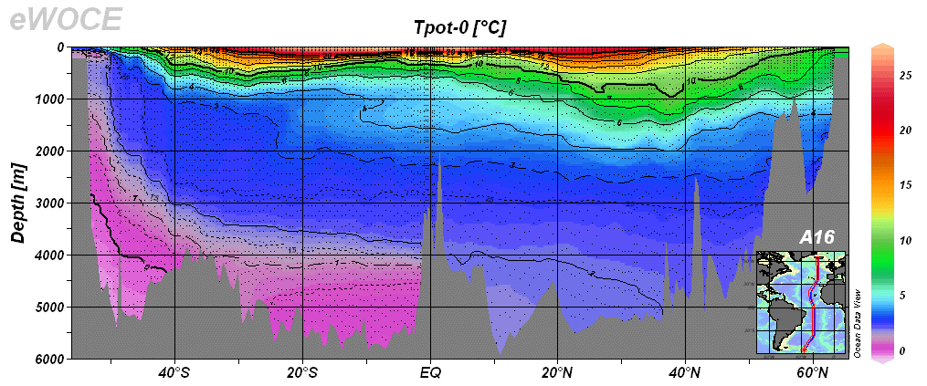

Slide 12
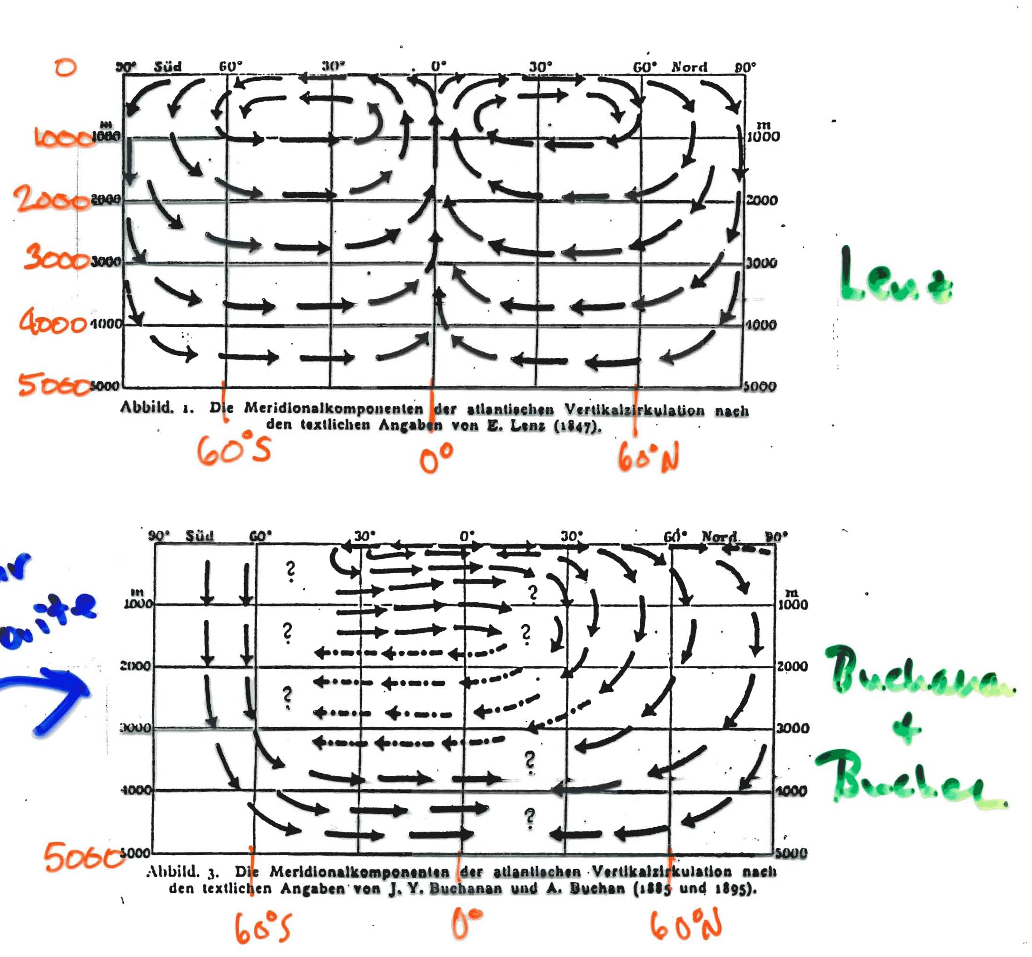
Historical views of Atlantic overturning
Question: Why not just a simple Hadley-type cell with sinking at high latitudes and upwelling at lower latitudes?
ANSWER: because the ocean has boundaries, its response to deep convection at high latitudes is not as simple

Slide 13
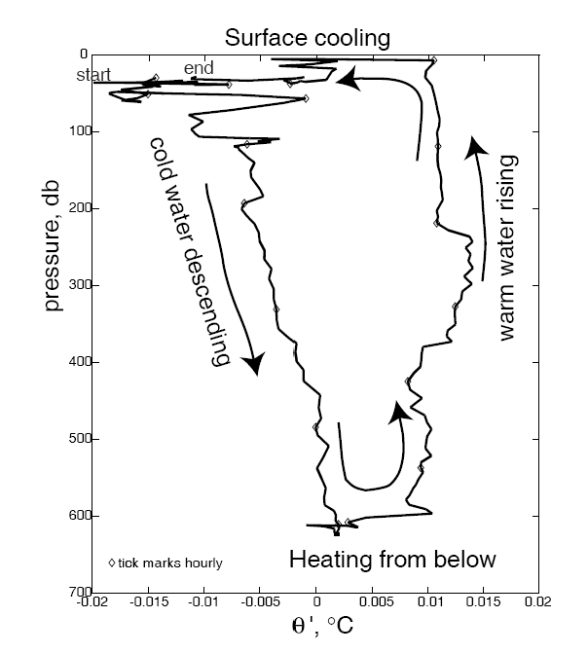
1. Deep convection observations
Example from the Labrador Sea

Slide 14
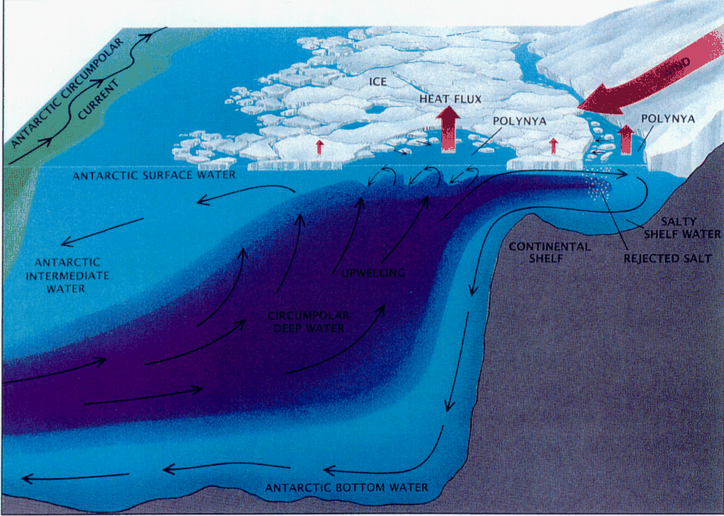
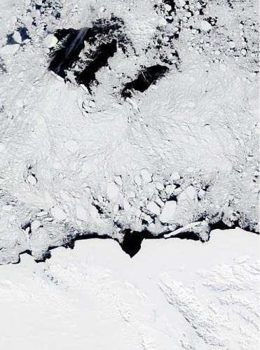
2. Process: Brine rejection
Polynyas: open water “ice factories”: water at freezing point, sea ice forms, rejects brine. Winds blow sea ice offshore and keep the polynya open and continuously freezing

Slide 15
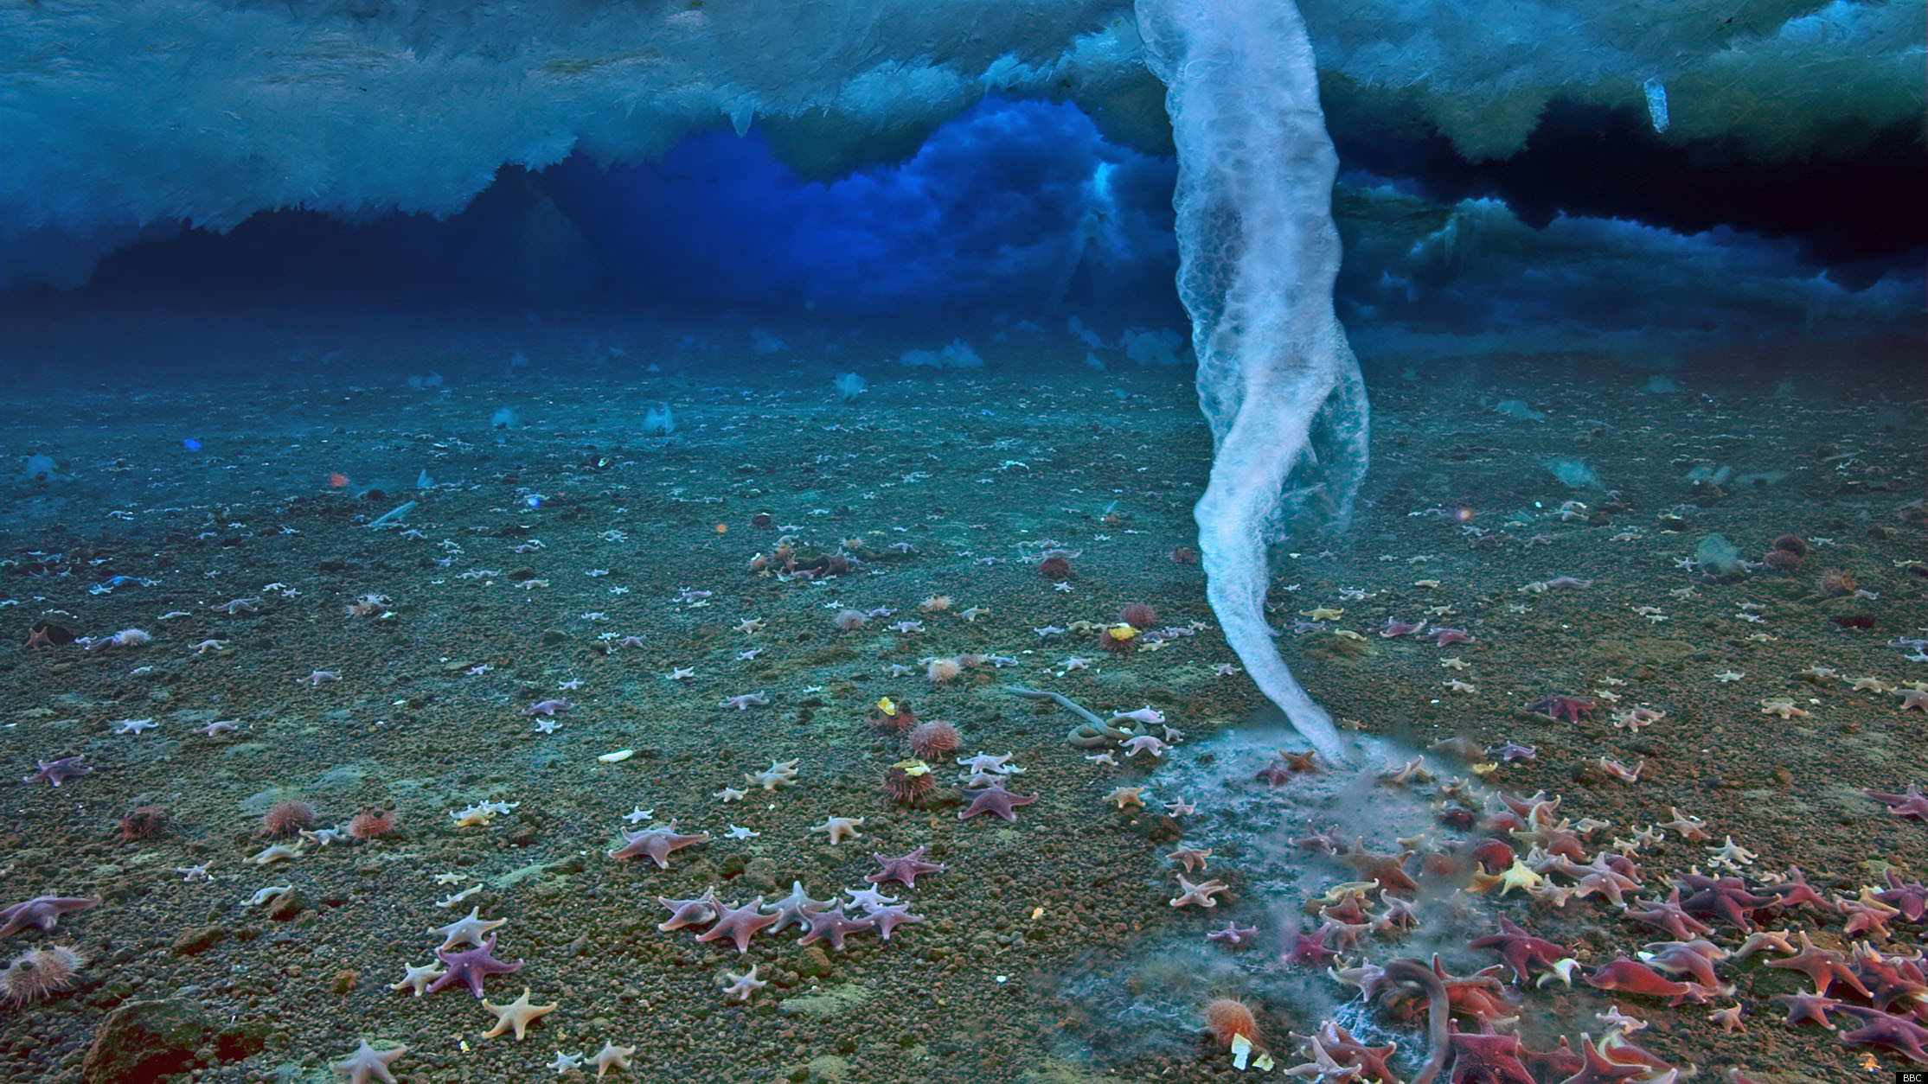
2. Process: Brine rejection
Brinicle (BBC) (look for online youtube video)

Slide 16
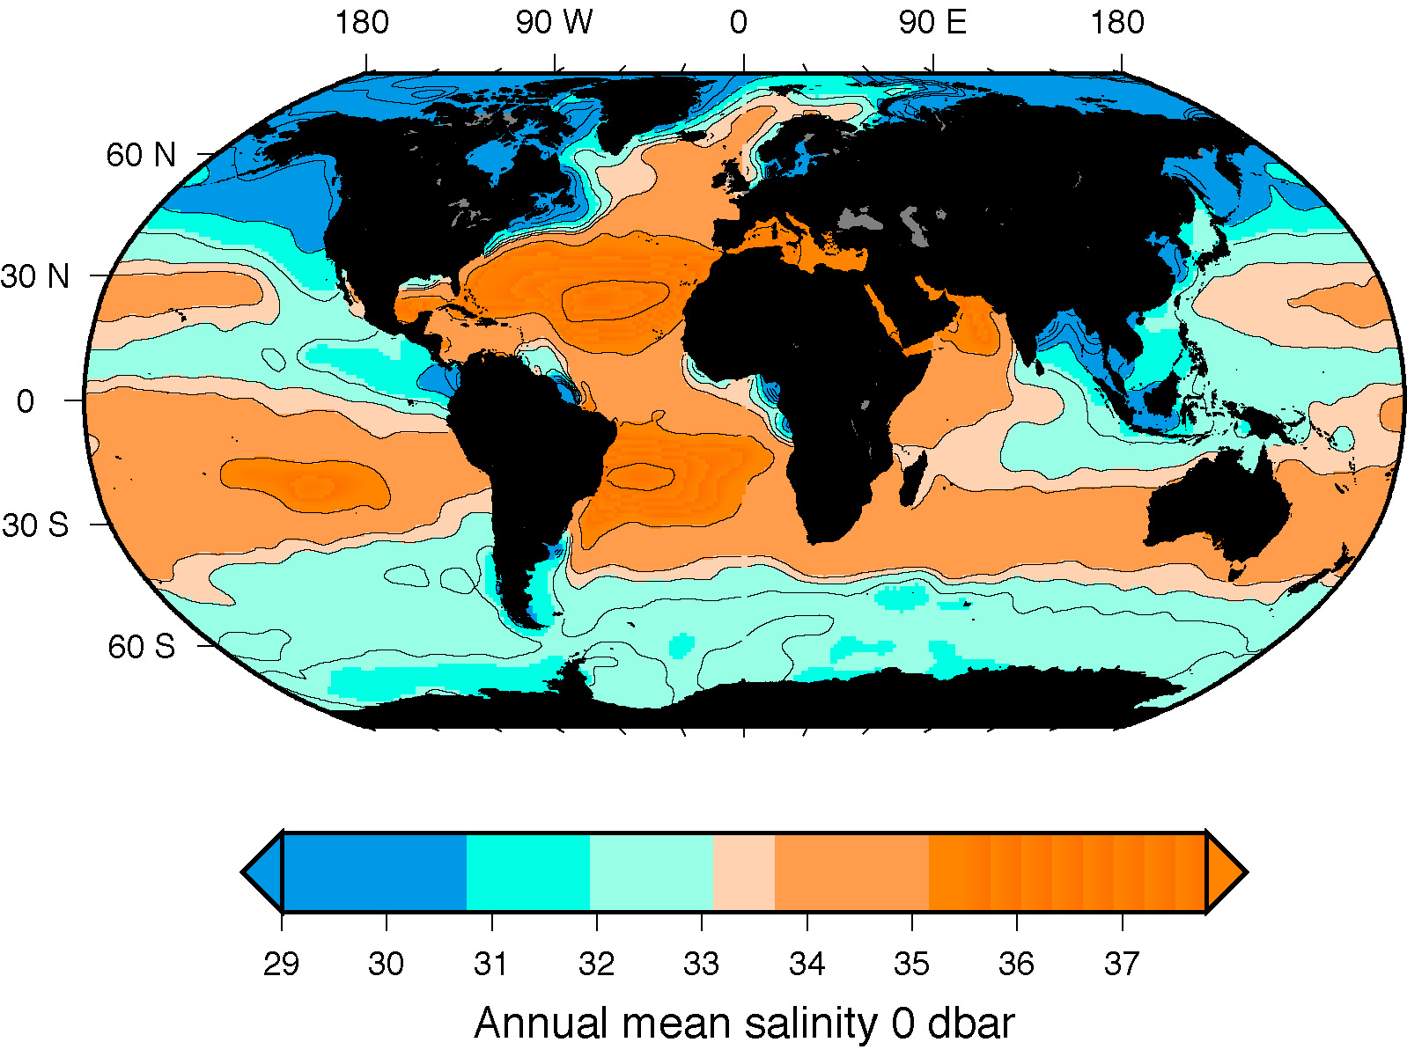
Deep convection and brine rejection sites
Labrador Sea Greenland Sea Mediterranean Red
B
X
B
B
B
X
B
X
X
X
X
B
B
B
B
Brine rejection in all sea ice areas
Ross Sea Weddell Sea

Slide 17
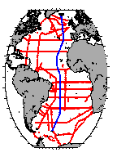
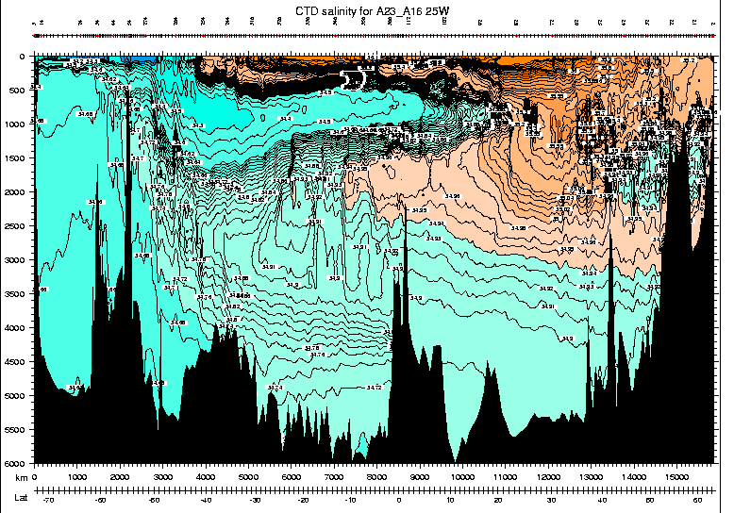
4 Process : NADW Formation and constituents: Atlantic 25W salinity
Blue: external source waters
thermocline
AAIW
NADW
AABW

Slide 18
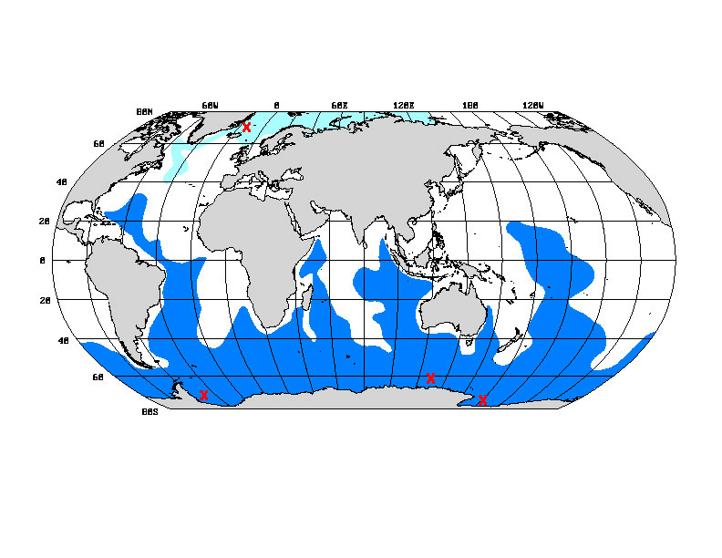
NADW inflow: AABW
Nordic Sea waters/NADW
Antarctic shelf waters (ice) /AABW or LCDW

Slide 19
North Atlantic Deep Water
Five sources:
Inflow: Upper layer water of N. Atlantic, from Gulf Stream through subpolar gyre, including Antarctic Intermediate Water and surface water from the Indian Ocean
Inflow: Bottom water from Antarctic (Antarctic Bottom Water)
Outflow: Evaporated, convected waters from Mediterranean Sea (Mediterranean Water)
Outflow: Intermediate depth convection in Labrador Sea (Labrador Sea Water)
Outflow: Intermediate-deep convection in Greenland Sea (Nordic Seas Overflow Water)

Slide 20
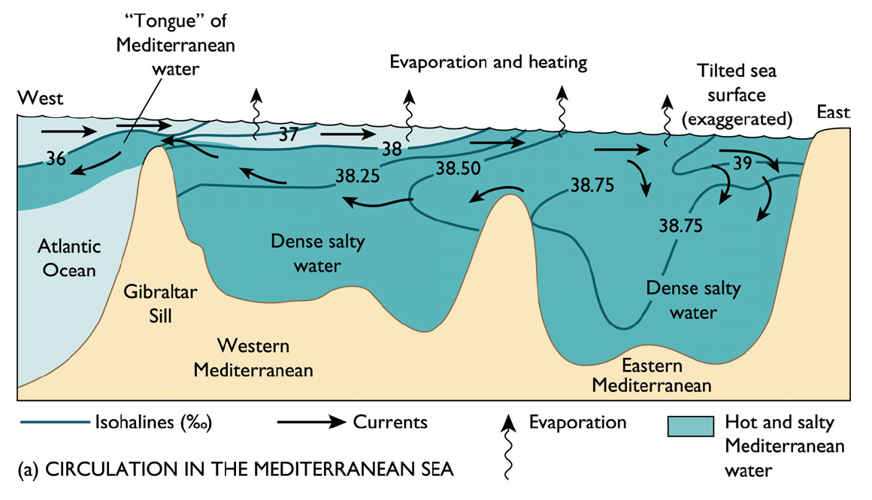
Formation of Mediterranean Intermediate Water (MIW)
MIW is warm (T~5-10°C) and very salty (S~35.5-35.9 psu). It forms by evaporation but is not dense enough (too warm) to reach densities greater than NADW.

Slide 21
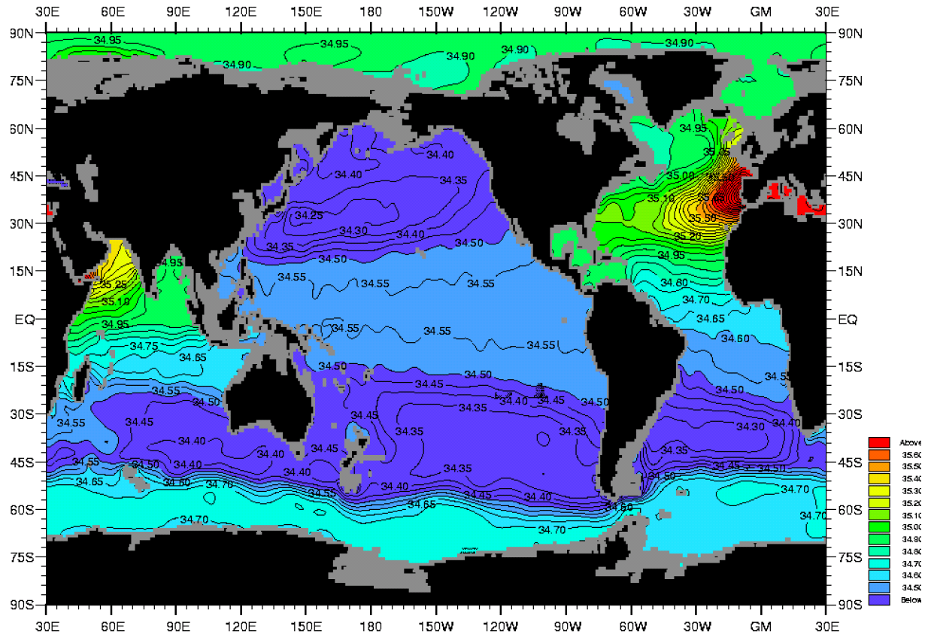
Average Salinity at a Depth of 1000 m.
Mediterranean Intermediate Water

Slide 22
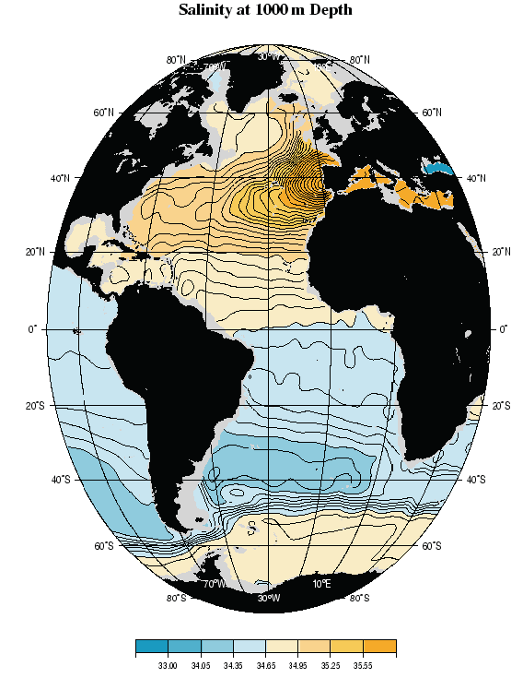
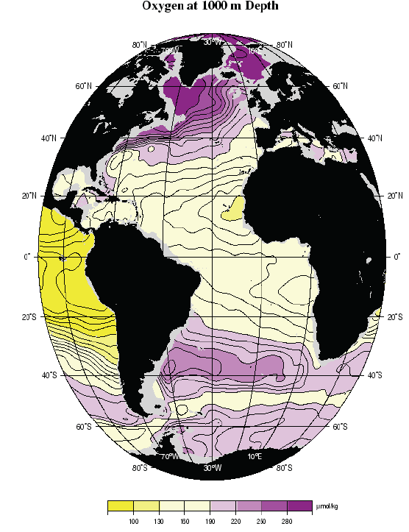
Atlantic 1000 m: Med. Water influence in salinity but very little effect on oxygen

Slide 23
North Atlantic Deep Water
Five sources:
Inflow: Upper layer water of N. Atlantic, from Gulf Stream through subpolar gyre, including Antarctic Intermediate Water and surface water from the Indian Ocean
Inflow: Bottom water from Antarctic (Antarctic Bottom Water)
Outflow: Evaporated, convected waters from Mediterranean Sea (Mediterranean Water)
Outflow: Intermediate depth convection in Labrador Sea (Labrador Sea Water)
Outflow: Intermediate-deep convection in Greenland Sea (Nordic Seas Overflow Water)

Slide 25
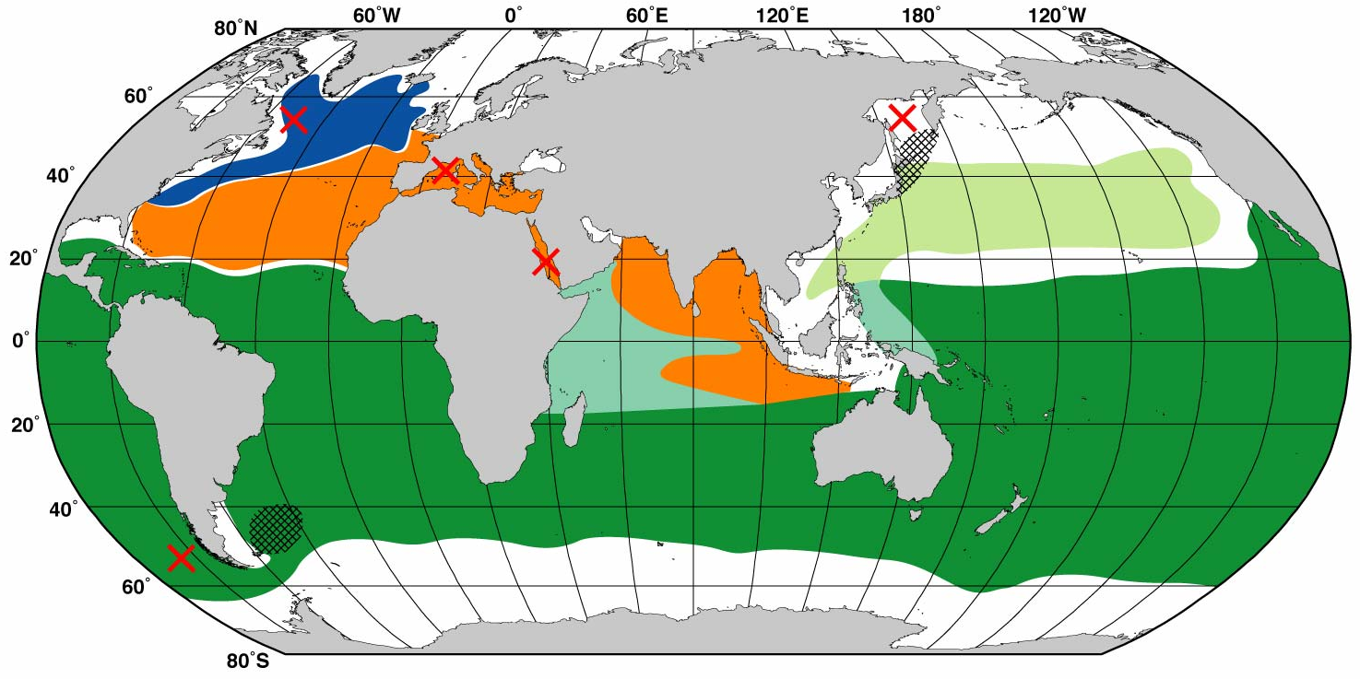
NADW source: Low salinity Labrador Sea Water: around 1000 to 2000 m depth
Labrador Sea Water - convection
x
LSW is formed in the Labrador Sea through deep convection

Slide 26
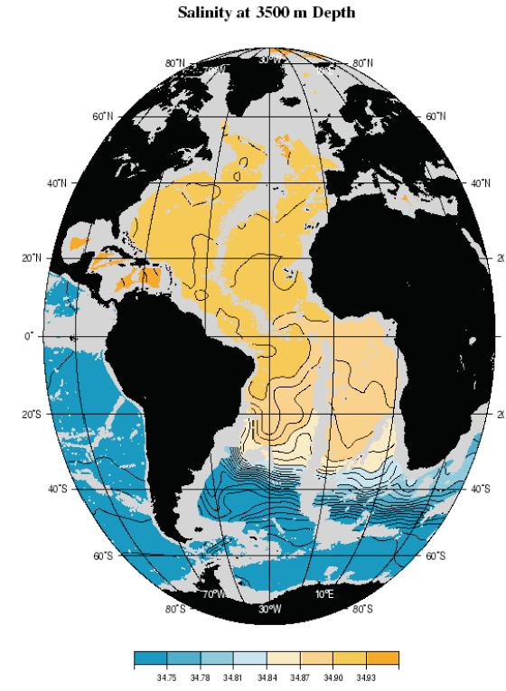
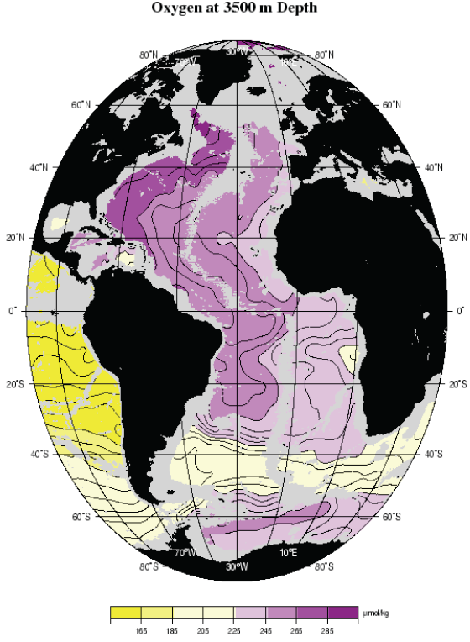
NADW sources: NSOW influences salinity and oxygen at 3500 m
Notes:
Woce atlas

